Slide 1
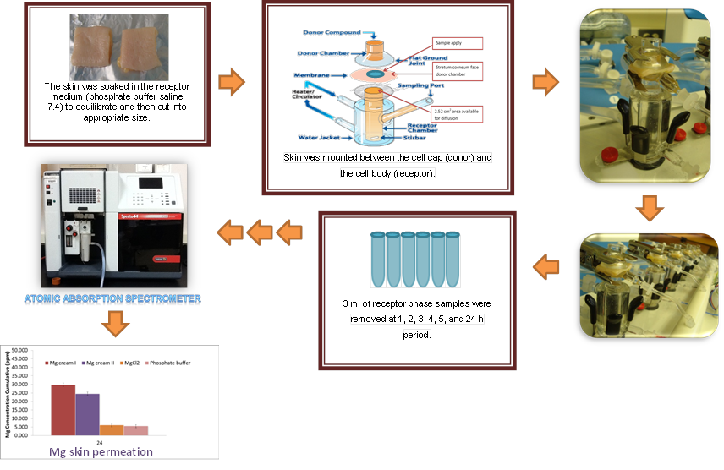
Preliminary study of Transdermal Permeation of Magnesium Cream Formulations across Skin
Sang-ngern Mayuramas¹, Jun Byoung¹, Hamad Mazen², Chang Leng Chee¹, Andrea Rosanoff³, Chougule Mahavir¹*
¹Department of Pharmaceutical Science, College of Pharmacy, University of Hawaii at Hilo , 200 W. Kawili St., Hilo, HI 96720, USA, ² Chemistry Department, University of Hawaii at Hilo, 200 W. Kawili St., Hilo, HI 96720, USA, ³ Center for Magnesium Education & Research, LLC, Pahoa, HI 96778, USA
OVERVIEW
EXPERIMENTAL METHODS
RESULTS
RESULTS
INTRODUCTION
Over 50% of adults in the USA does not get their daily requirement of Magnesium ( Mg) from foods (1). Hospitalized patients are especially at risk of Mg deficit, both with and without hypomagnesemia. Hypomagnesemia is an electrolyte disturbance in which there is an abnormally low level of Mg in the blood (2). Hypomagnesemia may result from a number of conditions including inadequate intake of Mg, chronic diarrhea, malabsorption, alcoholism, chronic stress, and use of medications such as diuretics (2). Deficiency of Mg causes weakness, muscle cramps, cardiac arrhythmia, respiratory arrest, increased irritability of the nervous system with tremors, athetosis, jerking, nystagmus and even death in some cases (2). In addition, disorientation, hallucinations, depression, epileptic fits, hypertension, tachycardia and tetany may also occur. Oral Mg supplements was found to absorb poorly and cause GI distress. The Institute of Medicine's Food and Nutrition Board have set magnesium's Upper Limit at 350 mg/day for men and women >8 yrs of age even though the RDA for adult men is 400 mg/day (3). This indicates that Mg supplementation is crucial for majority of human populations; however, the oral route for Mg supplements has some real problems associated with it. Although, the injection of Mg is available, an alternative delivery of Mg supplement via transdermal route will be ideal for efficient Mg supplementation which will improve the patient compliance (4). Transdermal delivery of medicines is safer, more efficient, convenient, patient friendly and less painful than injections or IV’s (4).
HYPOTHESIS:
We hypothesize that Mg supplement cream will deliver Mg via transdermal route of administration into the systemic circulation which may be helpful in the treatment of Hypomagnesemia.
OBJECTIVES:
To conduct the transdermal permeation studies of Mg supplement cream formulation across human skin using Franz diffusion set up.
To determine the extent of transdermal permeation of Mg from cream formulations by analyzing the samples for Mg content using atomic absorption spectroscopy.
The purpose of this study was to compare the passive permeation of Mg across human skin from pharmaceutical grade Mg Chloride (MgCl₂) formulated in cream to that of pharmaceutical grade MgCl₂ in solution.
MATERIALS:
The magnesium chloride (MgCl₂) cream formulation was formulated by Dr. Andrea Rosanoff, Director of Research & Science Information Outreach Center for Magnesium Education & Research Pahoa, HI 96778. The permeation study will be performed using human cadaver skin (Pelfreez, USA). Transdermal permeation of Mg supplement cream formulation across human skin was performed by using transdermal Diffusion Cell Drive Console (Logan Transdermal Testing System FDC-6). The atomic absorption spectroscopy method was used for the Mg analysis.
METHODS
Transdermal permeation of Mg from Mg supplement cream formulation across human skin: The skin was soaked in the receptor medium(phosphate buffer saline 7.4) to equilibrate and them cut into appropriate size. The transdermal Diffusion Cell Drive Console (Logan Transdermal Testing System FDC-6) was used to carry out this investigation. Skin was mounted between the cell cap (donor) and the cell body (receptor). The dermis was bathed from below with an isotonic saline solution injected through a port. Temperature was maintained at 37°C by thermostatically controlled water that enters the water jacket of the Franz diffusion cells. Homogeneous distribution of temperature in the phosphate buffer saline solution was accomplished by agitating motion of Teflon-covered magnetic stirring bar, driven by an external magnet and mounted on timing motor. The transdermal permeation efficiency of Mg from MgCl₂ cream I and MgCl₂ cream II was studied across skin compared to positive control MgCl₂ solution and negative control phosphate buffer solution. The cream or MgCl₂ solution equivalent to 2.76 mg of Mg were applied per 2.52 cm² of skin and mounted on diffusion cell. Samples were collected after 1, 2, 3, 4, 5 and 24 h and analyzed using Atomic absorption spectroscopy at 285 nm. The experiments were performed in triplicates. The results were analyzed using unpaired t-test.
Schematic 1 Representation of the in vitro skin permeation protocol
.
Analytical Method Development for Measurement of Mg using
Atomic absorption spectrophotometry
The calibration curve of Mg chloride solution was established by dissolving the various concentrations of Mg chloride in the phosphate buffer pH 7.4 and measuring the absorbance of the resulting aliquots at 285 nm using Atomic Absorption Spectrometer, using phosphate buffer as blank. Concentrations in the range of 1 ppm to 5 ppm were prepared by suitable dilution with phosphate buffer.
*
*
*
*
*
Time (h)
Figure 3 Cumulative in vitro permeation of Mg from Mg cream II compare to MgCl₂ solution across human skin using pH 7.4 phosphate buffer ( 37°C) as medium (n=3).
Mg cream I showed greater Mg permeation than Mg cream II, but the difference was not statistically significant. The MgCl₂ solution showed a similar result to that of phosphate buffer.
*
*
Figure 1 Standard curve of MgCl₂ analysis at concentration 1-5 ppm
Transdermal permeation of Mg across Human Skin
Permeation studies are carried out using modified Franz diffusion cell with the diffusion area 2.52cm². The permeation studies were carried using various formulation with 2.76 mg equivalence of Mg concentration at different time periods of 1, 2, 3, 4, 5, and 24 h.
Figure 4 Cumulative in vitro permeation of Mg cream I, Mg cream II, and MgCl₂ solution after 24 h across human skin using pH 7.4 phosphate buffer ( 37°C) as medium (n=3).
CONCLUSION
Table 1 Summary of average cumulative Mg passively permeated
across human skin
A formulated pharmaceutical grade Mg cream was able to successfully deliver the Mg across human skin.
Transdermal delivery of Mg may play an important role in the management of patient suffering from sub-optimal Mg status.
Time (hour) | Magnesium cream I |  | Magnesium cream II |  | MgCl₂ solution |  | Phosphate buffer
 | Mean | S.D. | Mean | S.D. | Mean | S.D. | Mean | S.D.
1 | 3.312 | 1.281 | 3.243 | 1.121 | 3.143 | 0.875 | 2.286 | 0.145
2 | 11.581 | 3.165 | 9.007 | 2.312 | 3.246 | 0.557 | 3.240 | 0.539
3 | 15.690 | 6.787 | 12.599 | 4.081 | 3.522 | 0.546 | 3.647 | 0.559
4 | 20.145 | 9.299 | 16.024 | 5.922 | 3.669 | 0.534 | 3.964 | 0.594
5 | 24.831 | 12.269 | 19.459 | 7.759 | 3.849 | 0.557 | 4.241 | 0.649
24 | 29.786 | 13.915 | 24.525 | 9.984 | 6.176 | 1.356 | 5.621 | 1.829
FUTURE DIRECTIONS
The cumulative Mg permeation from Mg cream I, Mg cream II, MgCl₂ solution, and phosphate buffer across human skin after 24 h were found to be 29.79±13.92, 24.53 ± 9.98, 6.18 ± 1.36, and 5.62 ± 1.83 μg/2.52cm² respectively. Comparison of permeation profile of Mg from Mg cream I, Mg cream II, MgCl₂ solution after 24 h. From the results it can be seen that both creams showed statistically significant (p < 0.05) Mg permeation compared with the two control solutions.
Transdermal permeation studies in a suitable animal model
Clinical Trials
Acknowledgements
The authors acknowledge the financial funding provided by Center for Magnesium Education & Research, LLC to perform these studies. The transdermal Diffusion Cell Drive Console (Logan System FDC-6) was provided by Department of Pharmaceutical Science, College of Pharmacy, UHH. Atomic Absorption Spectrometer was supported by Chemistry Department, UHH.
*
References
*
*
1. Moshfegh A, Goldman JD, Ahuja J, Rhodes D, LaComb R. What We Eat in America,
NHANES 2005-6: Usual Nutrient Intakes from Food and Water Compared to 1997
Dietary Reference Intakes for Vitamin D, Calcium, Phosphorus, and Magnesium.:
U.S. Department of Agriculture, Agricultural Research Service., 2009.
2. Hypomegnesemia (Cite 30 Sep 2012). Available from: URL:
http://www.ncbi.nlm.nih.gov/pubmedhealth/PMH0001358/
3. Standing Committee on the Scientific Evaluation of Dietary Reference Intakes
FaNB, Institute of Medicine. Dietary reference intakes for calcium, phosphorus,
magnesium, vitamin D, and fluoride. Washington, D.C.: National Academy Press,
1997:190-249.
Tanner T, Marks R. Delivering drugs by the transdermal route: review and comment.
Skin Research Technology 2008; 14(3):249-60.
*
*
Time (h)
Figure 2 Cumulative in vitro permeation of Mg from Mg cream I compare to MgCl₂ solution across human skin using pH 7.4 phosphate buffer ( 37°C) as medium (n=3).

